Slide 1


Phishing Detection Using ML
By Manar Ashiha & Shikah Alalyani
Data Science Bootcamp T5 2022

Slide 2
AGENDA
01
02
03
The Idea
Exploratory Data Analysis
Data Pre-Processing
04
05
01
02
03
04
05
06
Data Splitting
Model Building
Result

Slide 3
The Idea
SATURN
NEPTUNE
The Idea : Predicting Phishing Web Page Using Machine Learning
Phishing is a method of trying to gather personal information using deceptive e-mails and websites.
In this project, we read the data and looked at what are the features that gave us information on what are the attributes of a phishing website.
who is benefiting from it ?
Anti-phishing researchers
Anti-phishing company
End user
Saturn is the ringed one. It’s a gas giant, composed of hydrogen and helium. It’s named after the Roman god of agriculture
Neptune is the farthest planet from the Sun, the fourth-largest in our Solar System and also the densest

Slide 4
The Datasets
SATURN
NEPTUNE
We are using the Phishing_Legitimate_full dataset. Since CLASS_LABEL is a category variable, this is a Classification problem. The data contains 50 features (columns)extracted from 5000 phishing webpages and 5000 legitimate webpagesand 10000 data points (rows) .
Some of the features :
Identifier | Description
Frequent Domain Name Mismatch | Checks if the most frequent domain name in HTML source code does not match the webpage URL domain name.
Num Numeric Chars | Counts the number of numeric characters in the webpage URL.
Num Sensitive Words | Counts the number of sensitive words (i.e., "secure", "account", "webscr", "login","ebayisapi", "signin", "banking", "confirm") in webpage URL.
Pct Ext Hyperlinks | Counts the percentage of external hyperlinks in webpage HTML source code.
Pct Null Self Redirect Hyperlinks | Counts the percentage of hyperlinks fields containing empty value, self-redirect value such as "#", the URL of current webpage, or some abnormal value such as "file://E:/".
Saturn is the ringed one. It’s a gas giant, composed of hydrogen and helium. It’s named after the Roman god of agriculture
Neptune is the farthest planet from the Sun, the fourth-largest in our Solar System and also the densest

Slide 5
Exploratory Data Analysis EDA
SATURN
NEPTUNE
Three major EDA approaches that we Appling it in our project :
Descriptive statistics
Data visualisations
Data shaping
Through use these methods :
df.describe() to Show statics information
df.info() to prints information about a DataFrame including the index dtype and columns, non-null values and memory usage.
Df.shap to show how many data points , features and dimensionality of the DataFrame
Principal Component Analysis PCA
We Appling in our project because we have 50 features
Etc.
Saturn is the ringed one. It’s a gas giant, composed of hydrogen and helium. It’s named after the Roman god of agriculture
Neptune is the farthest planet from the Sun, the fourth-largest in our Solar System and also the densest

Slide 6
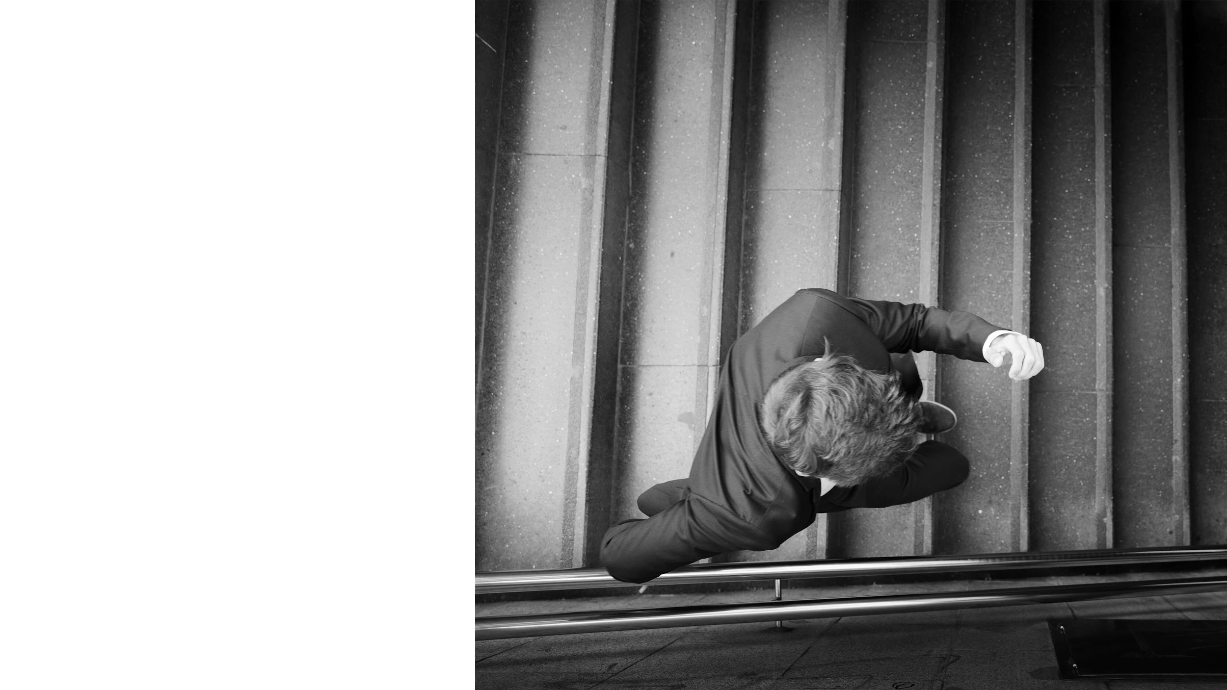
DATA VISUALISATIONS
We Use Pire plots , bar chart and scatter plots to visuals the data .

Slide 7
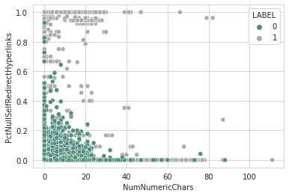
Scatter Plots
MERCURY
From the pair plot in the figure. we used a Scatter plot to observe and show relationships between Number numeric chars and Pct Null Self Redirect Hyperl inks. we found they have a good impact on the label..
Mercury is the closest planet to the Sun and also the smallest one in our Solar System. It’s only a bit larger than our Moon

Slide 8
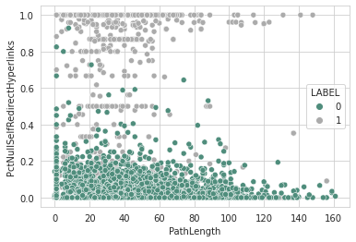
Scatter Plots
From the pair plot in the figure. we used a Scatter plot to observe and show relationships between Path Length and Pct Null Self Redirect Hyperl inks . we found they have a good impact on the label.

Slide 9
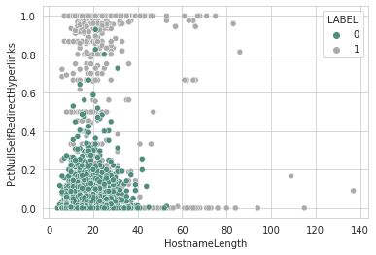
Scatter Plots
From the pair plot in the figure. we used a Scatter plot to observe and show relationships between Hostname Length and Pct Null Self Redirect Hyperl inks .we found they have a good impact on the label.

Slide 10
Data Pre-Processing
SATURN
NEPTUNE
Data pre-processing (also known as data cleaning, data wrangling or data munging)
in this phase after we exploring the data we decide to :
remove the id features
rename the CLASS_LABEL to LABLE
Saturn is the ringed one. It’s a gas giant, composed of hydrogen and helium. It’s named after the Roman god of agriculture
Neptune is the farthest planet from the Sun, the fourth-largest in our Solar System and also the densest

Slide 11
Data Splitting
SATURN
NEPTUNE
We split the data into the training set ( 80% of the original data) and the testing
set (the remaining 20% of the data).
Also we use features scaling to normalize the range of independent variables or
features of data in order to increase the performance of modeling.
Saturn is the ringed one. It’s a gas giant, composed of hydrogen and helium. It’s named after the Roman god of agriculture
Neptune is the farthest planet from the Sun, the fourth-largest in our Solar System and also the densest

Slide 12
Model Building
SATURN
NEPTUNE
We applied 3 models :
Logistic Regression
Naive bayes classifier
Random Forest Classifier
Saturn is the ringed one. It’s a gas giant, composed of hydrogen and helium. It’s named after the Roman god of agriculture
Neptune is the farthest planet from the Sun, the fourth-largest in our Solar System and also the densest

Slide 13
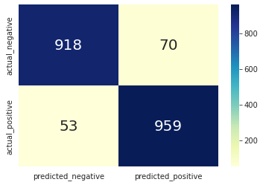
Logistic Regression
SATURN
NEPTUNE
In the a logistic Regression model we use (LABEL) as a target variable which
have two possible value (0,1) .this technique is used while dealing with binary
data.
Saturn is the ringed one. It’s a gas giant, composed of hydrogen and helium. It’s named after the Roman god of agriculture
Neptune is the farthest planet from the Sun, the fourth-largest in our Solar System and also the densest
# apply logistic regression
from sklearn.linear_model import LogisticRegression
lr = LogisticRegression()
lr.fit(X_train_scaled,y_train)

Slide 14
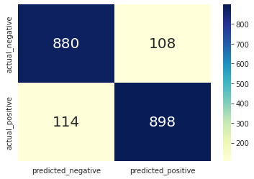
Naive bayes Classifier
SATURN
NEPTUNE
In the Naïve Bayes model we used Bernoulli for discrete data, where target
feature are only in binary form. It assumes that the presence of a particular
feature in a class is unrelated to the presence of any other feature.
Saturn is the ringed one. It’s a gas giant, composed of hydrogen and helium. It’s named after the Roman god of agriculture
Neptune is the farthest planet from the Sun, the fourth-largest in our Solar System and also the densest
#construct naive bayes BernoulliNB classifier
from sklearn.naive_bayes import BernoulliNB
nb = BernoulliNB()
nb.fit(X_train_scaled, y_train)
nb.score(x_test, y_test)

Slide 15
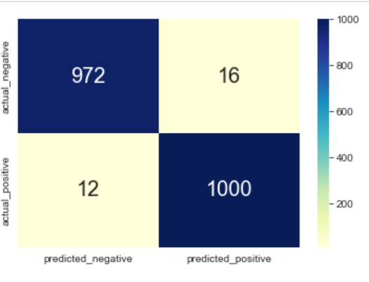
Random Forest Classifier
SATURN
NEPTUNE
Random Forest is an ensemble model that contains a number of decision trees
it is working in the sequential way which is Each individual model learns from
mistakes made by the previous model .
Saturn is the ringed one. It’s a gas giant, composed of hydrogen and helium. It’s named after the Roman god of agriculture
Neptune is the farthest planet from the Sun, the fourth-largest in our Solar System and also the densest
# applay Random Forest
from sklearn.ensemble import RandomForestClassifier
rf= RandomForestClassifier()
rf.fit(X_train_scaled,y_train)

Slide 16
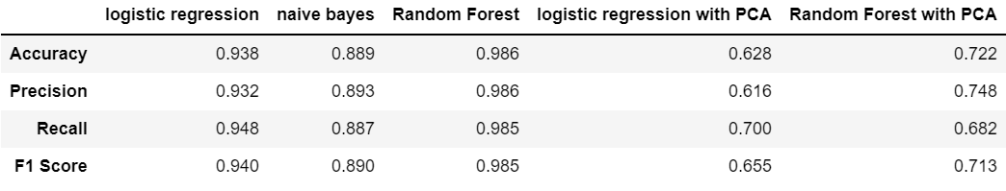
Compare Between Classifier Models
SATURN
NEPTUNE
Saturn is the ringed one. It’s a gas giant, composed of hydrogen and helium. It’s named after the Roman god of agriculture
Neptune is the farthest planet from the Sun, the fourth-largest in our Solar System and also the densest

Slide 17
Result
SATURN
NEPTUNE
Finally, in this project, we used three model to detect phishing happens based on 50 features extracted from 5000 phishing, Then we discovered the Random Forest algorithm for machine learning is the best algorithm that detects phishing happens. Based on the accuracy factor we getting 98% in the Random Forest model ,93% for logistic regression model, and 88% in the naive bayes model . And because we have a large number of the features, So we used the Feature Scaling technique, which in turn contributed to raising the level of performance of the models and we obtained high accuracy in the results . Then we use the PCA technique which reduces the number of features until we get the most important features, but it did not give us good results.
Saturn is the ringed one. It’s a gas giant, composed of hydrogen and helium. It’s named after the Roman god of agriculture
Neptune is the farthest planet from the Sun, the fourth-largest in our Solar System and also the densest

Slide 18
Thanks
Does anyone have any questions?

